Slide 1

SMART AGRICULTURE SYSTEM USING IOT
By Samiksha Mulik

Slide 2
Overview
A web application used to control motors in agricultural field from remote locations using data uploaded to the cloud from the field.
The web application collects data generated by the IoT simulator from the cloud and displays it.
Depending on the data, the user can control the motors from any remote location via internet.

Slide 3
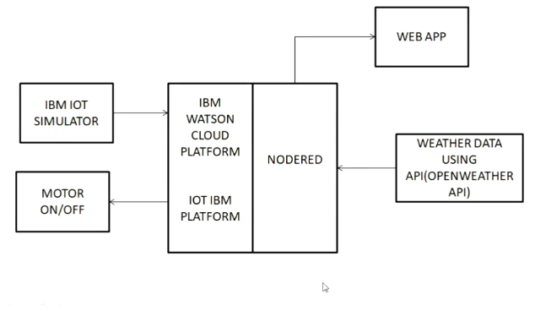
Block diagram

Slide 4
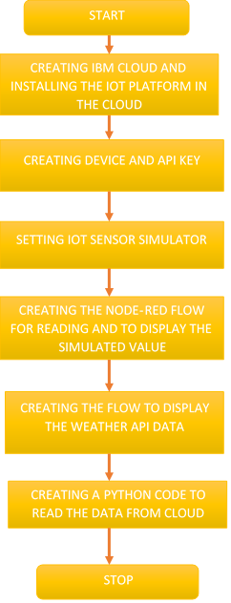
Steps

